Slide 1
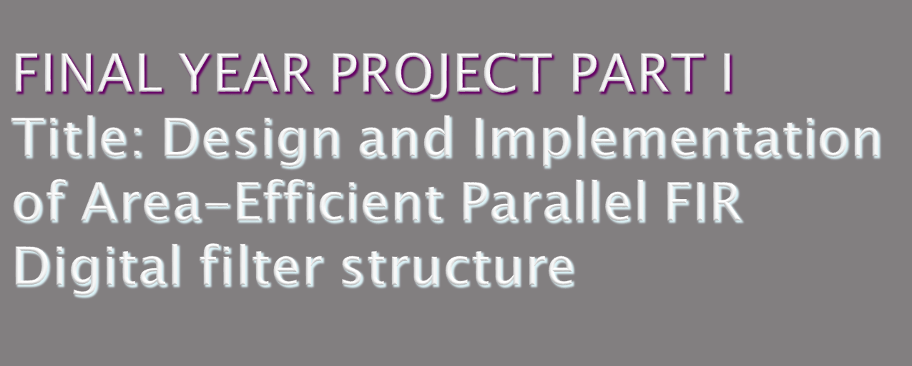
Name:Tharmarajhan A/L Loganathan
ID :1101110080
Supersior :
Moderator:

Slide 2

In signal processing, a filter is a device or process that removes from a signal some unwanted component or feature
Designing a parallel FIR filter with reduced area
Area Efficient FIR filter is achieved by exploiting the inherent nature of symmetric coefficients to reduce the number of multipliers in the sub filter section at the expense of increase in adders in pre-processing and post-processing blocks.

Slide 3

Parallel implementation causes high manufacturing cost
Therefore exchanging multipliers with adders is advantageous because adders weigh less than multipliers in terms of area
There are three main component in filter namely adder, multiplier and delay

Slide 4

The design of the FIR digital must have the following criteria:
Less occupying area – Smaller in the size, and hence cost cheaper.
Low power – Generates less heats and better reliability.
Low propagation delay – Higher speed in data processing and high throughput

Slide 5

Component design
Adder
Multiplier
Delay
Filter design
Analyze and simulate
the schematic
& layout
Output results

Slide 6
Filter design
Filter designed to demonstrated the symmetric nature of filter
Component design
The basic components are designed which is needed in implementing the filter design.
Adder , multiplier and delay

Slide 7
Analyze and Simulate the Schematic & Layout
Compile the schematic and simulate the layout design using CAD tools and simulate the design in MATLAB
Output Results
Record and calculate the output based on design parameters

Slide 8

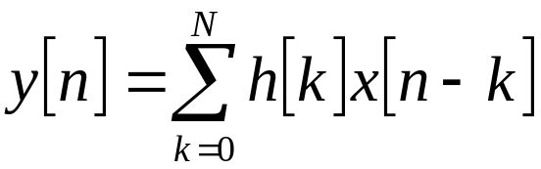
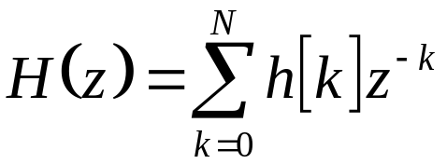
FIR Filter
The input and output relation of FIR filter in time domain
The transfer function of FIR filter

Slide 9
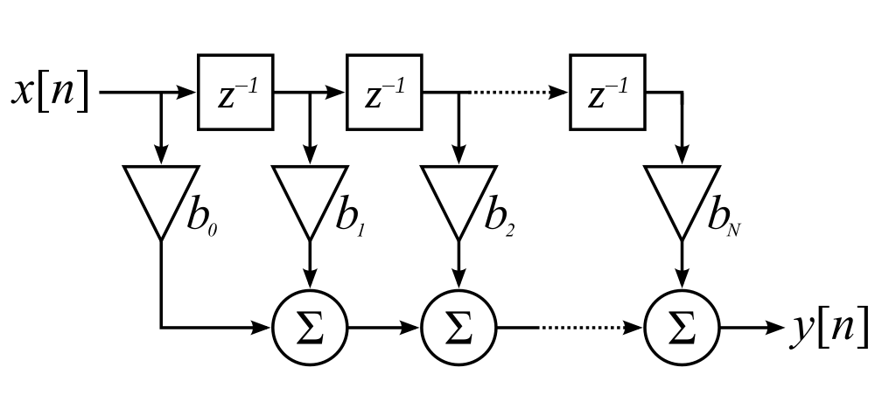
Consider a FIR filter of Nth order, the implementation of the filter in Direct Form as below.
It requires N+1 multipliers and N two input adders

Slide 10


FFA(Fast FIR Algorithm)
The number of multipliers can be reduced through Linear Phase FIR Structures
Consider a length-7 Type 1 FIR transfer function with a symmetric impulse response
Rewriting the H(z) in the form

Slide 11
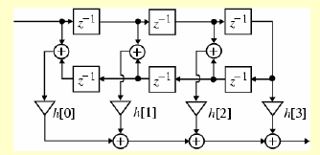
The realization shown of the filter is shown below:
The number of multipliers has been reduced to 4 compared 7 in direct form realization

Slide 12
The number of multipliers can be further reduced by polyphase decomposition method
Consider a causal FIR transfer function H(z) with N=6
H(z) = h[0]+h[1]z⁻¹+ h[2]z⁻²+ h[3]z⁻³+ h[4]z⁻⁴+ h[5]z⁻⁵+ h[6]z⁻⁶
H(z) can be expressed as a sum of two terms, with one term containing the even-indexed coefficients and the other containing the odd-indexed coefficients

Slide 13
H(z) can be expressed as a sum of two terms, with one term containing the even-indexed coefficients and the other containing the odd-indexed coefficients
H(z) = (h[0] + h[2]z⁻²+ h[4]z⁻⁴+ h[6]z⁻⁶)
+( h[1]z⁻¹+ h[3]z⁻³+ h[5]z⁻⁵)
      = (h[0] + h[2]z⁻²+ h[4]z⁻⁴+ h[6]z⁻⁶)
      + z⁻¹( h[1]+ h[3]z⁻²+ h[5]z⁻⁴)

Slide 14


By using the notation
We can express H(z) as
This is called 2-branch polyphase decomposition

Slide 15
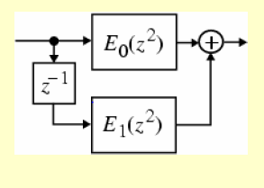
The realization of 2 branch polyphase decompostion
The Structure can be further decomposed into more than two branch which will be done in phase 2
The subfilters in the polyphase realization of an FIR transfer function are also FIR filters
Thus, this further reduces the number of multipliers

Slide 16

The basic components is design in transistor level namely adder, multiplier and the delay using CMOS Technology.
The components will be then compiled together to implement the proposed FIR Filter Structure.
The proposed filter design will be implemented and verified in transistor level using the CAD software.
Export the design implemented in CAD software to MATLAB.

Slide 17
The design will be simulated for lowpass filtering and performance of the design is analyzed according to the required parameters.

Slide 18

The schematic design using following tool:
Export DSCH2
The layout design using following tool:
Export Microwind2
The simulation of the proposed design using following tool:
MATLAB

Slide 19

The proposed FIR filter will be developed for a higher order to compare the performance of the filters.
Besides the proposed design, the performance of the filter is also depends on the basic component’s schematic and layout designed in CAD software.

Slide 20
The area of the design
Propagation delay, т Power dissipation, Pd
Latency, T
Throughput, R

Slide 21
Q/A

